Slide 1

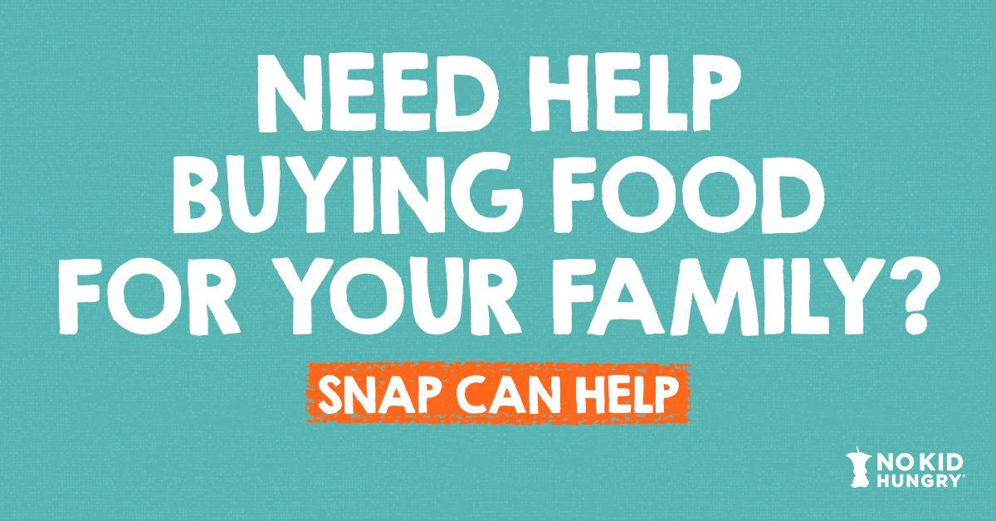
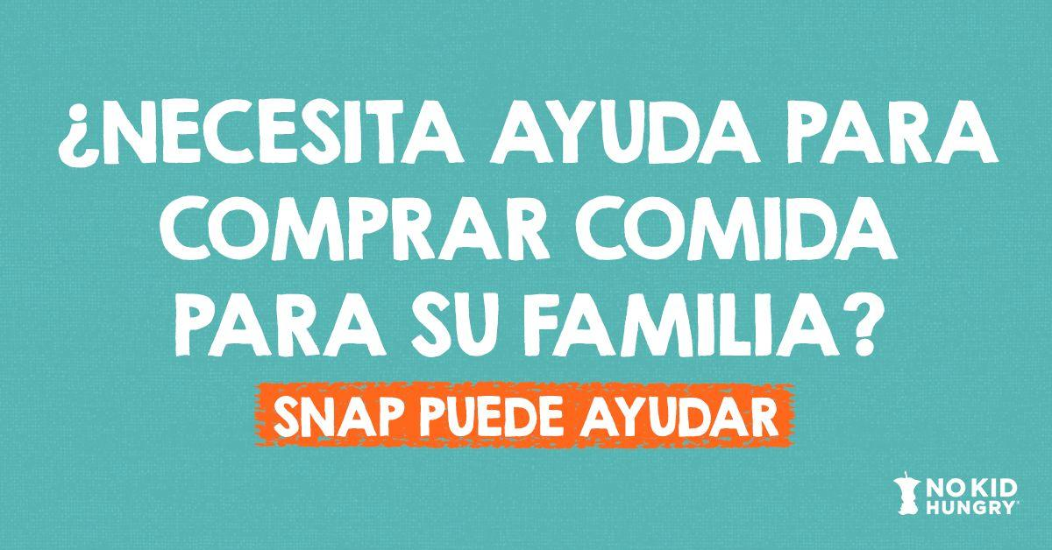
SNAP OUTREACH
Resources To Reach Families during the Pandemic
The Supplemental Nutrition Assistance Program (SNAP) is one of the most effective ways to feed kids. The average monthly benefit, about $125 per person, is uploaded to an Electric Benefit Transfer (EBT) card and can be used to purchase food at places like grocery stores and farmers’ markets.
As trusted messengers, schools and community organizations are an important source of information for families.
Tools to Connect Families to SNAP
The following toolkit includes sample SNAP outreach materials in English and Spanish. Please feel free to customize these assets with details and specifics that best serve your community.
  Why SNAP Outreach? + Considerations (p.2)
  Sample Language for Flyers, Emails/Letters to Families, and Robo-Calls (p.3-4)
  Sample Social Media Posts (p.5)
  Template Flyers (p.6-7)
  Images for Social Media Posts (English and Spanish) here

Slide 2
Why is SNAP Outreach Important?
SNAP is Important for Students & Families
      Students with SNAP get the food they need to succeed at home and school.
      At Home: SNAP helps parents afford groceries, but many newly eligible families may not know they qualify, or how to sign up.
      At School: Students enrolled in SNAP are directly certified for free school meals, which reduces the number of meal applications that schools must process and verify.
      In the Classroom: When students consistently get the food they need, it leads to lower rates of chronic absenteeism, stronger test scores, and fewer disruptions caused by behavior or trips to the nurse.
SNAP is Important for School Nutrition Departments
For School Nutrition Budgets: Students enrolled in SNAP are automatically certified for free school meals. That means fewer school meals applications to process, and fewer unpaid meal charges.
For Program Design: When SNAP reaches more of the students who need it, it improves a school’s ability to operate summer and afterschool meal programs and to adopt the Community Eligibility Provision (CEP), which enables schools to serve meals to all students at no cost to families. Learn more about CEP.
Not every state calls it SNAP
Find the name for SNAP in your state here.
Most states are accepting SNAP applications online and over the phone
See the flexibilities available in your state here.
Immigrant families may be hesitant to enroll
Enrolling in SNAP could have a negative effect on citizenship applications. For community-facing information and resource, visit Protecting Immigrant Families (PIF) at https://protectingimmigrantfamilies.org/
CONSIDERATIONS

Slide 3
Sample Outreach Messages
for English-Speaking Families in your Community
Email or Letter to Families
Dear Families,
As you know, the coronavirus has caused a catastrophic economic crisis as well as a health one. This pandemic continues to impact families in our district in many ways, including layoffs, income changes and financial strain.
If you need assistance with food, you may be eligible for a benefit through the Supplemental Nutrition Assistance Program (SNAP). SNAP provides a monthly benefit on an Electronic Benefit Transfer (EBT) card that can be used to buy food at grocery stores, farmers’ markets, and any food store posting the USDA sign “EBT Accepted.”
The card is mailed to your house and benefits are uploaded each month directly on the card. On average, families receive $246 per month to purchase food.
If you have questions or want more information, please visit our website at [INSERT DISTRICT WEBSITE] or call [INSERT PHONE NUMBER].
Have a safe, healthy [INSERT MONTH OR SEASON].
Robocall Script
Hello, this is [NAME OF SUPERINTENDENT OR PRINCIPAL OF SCHOOL].
The coronavirus created an economic crisis and a health crisis in our community. This pandemic continues to impact families in our district in many ways, but there are programs that can help.
You may be eligible for SNAP, a program that helps you buy food for your family, especially if you’ve recently lost income. You can apply for SNAP at [LINK TO STATE SNAP APPLICATION].
This summer, you can also pick up free meals for kids [details about meals program].
If you have questions or want more information, please visit our website at [INSERT DISTRICT WEBSITE] or call [INSERT PHONE NUMBER]

Slide 4
Sample Language: Spanish
for SNAP Outreach to Families in your Community
SNAP Outreach Flyer
En [NAME OF SCHOOL DISTRICT], sabemos que este es un momento difícil para las familias. Si su familia ha perdido ingresos recientemente debido a la COVID-19, SNAP puede ayudarlos. SNAP es un programa creado para complementar los presupuestos alimentarios de las familias.
Para solicitarlo, visite [WEBSITE] o llame al [PHONE NUMBER].
Email or Letter to Families
Queridas Familias,
Les escribimos para informarlos sobre un programa que podría beneficiarlos a ustedes y a sus hijos.
¿Se han reducido los ingresos en su familia recientemente debido a la COVID-19? Si es así, puede que califique para recibir ayuda con su presupuesto alimentario por medio del Programa de Asistencia Nutricional Alimentaria (SNAP). Con SNAP puede comprar más alimentos saludables para su familia y estirar su presupuesto para comida.
Los beneficios de SNAP se distribuyen mensualmente mediante una tarjeta de transferencia electrónica de beneficios (Electronic Benefits Transfer, EBT) que le envían a su casa. Los depósitos mensuales se añaden directamente a la tarjeta. La tarjeta SNAP EBT se usa como una tarjeta de débito y se acepta en supermercados, la mayoría de las tiendas y en muchos mercados de agricultores, o en los puntos de venta donde vea el letrero de USDA que diga “se acepta EBT” (EBT accepted).
Para solicitar SNAP, visite WEBSITE o llame al XXX-XXX-XXXX. Tenga un verano seguro y saludable.
Robocall Script
Hola! Me llamo [NAME] y soy [POSITION/TITLE] de su escuela.
Llamo para informarlos sobre un programa que podría beneficiarlos a ustedes, a sus hijos y a su escuela.
El Programa de Asistencia Nutricional Alimentaria o SNAP hace que sea más fácil para las familias comprar comida y podría ser una opción para ustedes si han perdido ingresos recientemente.
Para recibir más información sobre SNAP y para solicitarlo, visite WEBSITE o llame al XXX-XXX-XXXX.”
Tenga un verano seguro y saludable.

Slide 5
English
If you’ve lost your job due to #COVID19 and need help putting food on the table for your kids, you’re not alone. Learn more about how SNAP can help your family: https://bit.ly/2YSnTQ8
As unemployment has grown due to #COVID19, many families need help putting food on the table. Learn more about eligibility for SNAP and how to apply here: https://bit.ly/2YSnTQ8
If your income has changed due to #COVID19, SNAP can help with groceries. Learn more here: https://bit.ly/2YSnTQ8
#COVID19 has caused an economic crisis as well as a health one. If you’ve been affected and need assistance with food, you can apply for SNAP to help buy groceries to feed your family. Learn more here: https://bit.ly/2YSnTQ8
SOCIAL MEDIA
Spanish
Si ha perdido su trabajo debido al #COVID19 y necesita ayuda para poner comida en la mesa para sus hijos, no está solo. Obtenga más información sobre cómo SNAP puede ayudar aquí: https://bit.ly/2YSnTQ8
A medida que aumenta el desempleo debido al #COVID19, muchas familias necesitan ayuda para poner comida en la mesa. Obtenga información sobre si cumple los requisitos para obtener SNAP y cómo solicitarlo aquí: https://bit.ly/2YSnTQ8
Si sus ingresos han cambiado debido al #COVID19, SNAP le puede proporcionar ayuda para obtener los alimentos que su familia necesita. Obtenga más información aquí: https://bit.ly/2YSnTQ8
#COVID19 ha ocasionado tanto una crisis económica como de salud. Si ha sido afectado y necesita ayuda con alimentos, puede solicitar SNAP para ayudarle a comprar la comida para su familia. Obtenga más información aquí: https://bit.ly/2YSnTQ8
Graphics to use in social media posts (English and Spanish) can be found here.

Slide 6

Insert Custom Text
Insert Custom Text
Insert Custom Text
REPLACE WITH YOUR LOGO

Slide 7
Insert Custom Text
Insert Custom Text
Insert Custom Text
REPLACE WITH YOUR LOGO

