Slide 1


Welcome!
Please share in the chat:
What school or organization are you a part of?
On a scale of 1-5, how familiar are you with Summer EBT?
1 = this is my first time hearing about it
5 = I’m a Summer EBT expert
Notes:
Kayte

Slide 2



Summer EBT Webinar for Nebraska School Staff & Community
Wednesday, April 23rd
Notes:
Kayte

Slide 3

Our goals for today’s webinar:
Help you understand how Summer EBT will work in Nebraska
Provide easy ways for you to help get the word out in your community
Ensure the right people at your schools have the right info
Provide an opportunity for Q&A
Notes:
Chloe
Help you understand how Summer EBT will work in Nebraska
Provide easy ways for you to help get the word out to your community
Ensure the right people at your school(s) have the information you might need to answer basic questions you may get from families about Summer EBT
Give you an opportunity to ask questions
As trusted teachers, school staff, and community members, we’ve created communication materials to help you share this message with your students and their families.
With this webinar, we hope to reduce stress/confusion related to Summer EBT among school staff, and indirectly among families

Slide 4
Here’s what we’ll cover today:
How Summer EBT will work in Nebraska, including what’s new in 2025
What does this mean for you? (Especially if you’re in a CEP school!)
Questions you may get from families
How Summer EBT and Summer Meals work together
Walk through the School Summer EBT Outreach Kit
Q&A!
Notes:
Chloe

Slide 5



Summer EBT in Nebraska
Notes:
Chloe

Slide 6
Last year, Summer EBT helped 175,000 children in Nebraska get the healthy food they usually enjoy at school.
Summer EBT is for school-aged children in households that are at or under 185% of federal poverty guidelines.
Families receive $120 per school-aged child for groceries.
The benefit is delivered on a 2025 Summer EBT card. Eligible children in the same household will have their benefits loaded onto a single card.
Notes:
Chloe
All families, regardless of their immigration status, are eligible.

Slide 7



Understanding Summer EBT eligibility for your students
Notes:
Chloe

Slide 8
Most eligible families will be automatically enrolled, but some will need to apply.
Children should receive Summer EBT automatically if:
  They receive SNAP, ADC, FDPIR, or income-based Medicaid (<185% FPL)
  Are in foster care, or identified at their school as homeless, migrant, or runaway
  Their family has completed and were approved for a Free & Reduced Price School Meals Family Application (in non-CEP traditional pricing schools)
There are many students whose household income is within 185% FPL, but aren’t participating in any of these programs, especially in CEP schools. We want to work extra hard to inform these families!
Notes:
Chloe
Practically speaking, things look a bit different if your child is at a CEP school or at a non-CEP school.

Slide 9
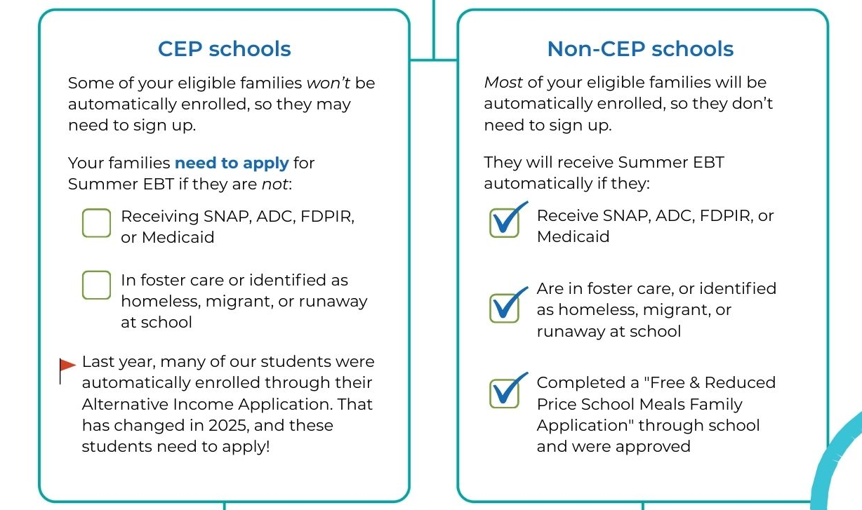
Okay! So…. will my students need to sign up for Summer EBT, or will they get it automatically?
Notes:
Chloe
Make it conversational - so what does this mean for me at my school?

Slide 10
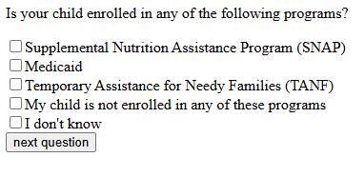
Families can check here if they need to apply.
Remember, most eligible families will be automatically enrolled, but some will need to apply.
Check out: bit.ly/NE-SEBT-eligibilitychecker (coming soon!)
Notes:
Elyse
Mention it’s not ready until Friday

Slide 11
For households that need to apply for one or more children:
Families must apply for Summer EBT by August 20, 2025
Summer EBT application online at bit.ly/NE-SEBT-application
  Online application is in English and Spanish
  If a family needs a paper application, they can be downloaded from NDE’s Summer EBT Application page
Notes:
Elyse

Slide 12
What’s changed in 2025?
The Alternative Income Application, used in CEP schools, can no longer be used to automatically enroll children. Children who received Summer EBT benefits this way last year need to apply this year.
Notes:
Elyse
So if you know your school or district used Alternative Income Applications to streamline certify (automatically enroll) kids last summer, they’ll be expecting to get the benefit again automatically - critical to get this message to those families.

Slide 13
How you can help families understand and access
Summer EBT
Notes:
Chloe
What does this mean for you?

Slide 14
In non-CEP, traditional pricing schools: Focus on awareness
If you are in a traditional pricing school (non-CEP), very few kids will need to apply. The vast majority would be participating in one of those programs, or would be would be caught through those F/R forms. (Which is great news!)
For your students and their families, you can focus on awareness. You can help answer questions about what the benefit is and how they’ll receive it, explain what it is so that they do not worry about receiving it automatically, and make sure they know how to use it.
Notes:
Chloe

Slide 15
In CEP schools: Focus on action
In CEP schools, there will be a group of your students who need to apply.
It can be complicated for families to understand the intricacies of the program, so we can help make it simple by focusing on a key message: “This program exists, and it’s easy to check your eligibility and apply.”
You can help answer questions on how to check eligibility, how to apply, and how to use their benefit.
Notes:
Chloe

Slide 16
Questions you may get from families
How and when will we get our Summer EBT benefits?
I’m having trouble activating my card – what should I do?
Why did I get Summer EBT for one child but not all of my children?
I think I should have gotten Summer EBT for my children automatically but didn’t. What should I do? …. But we received it automatically last year!
  First issuance planned for this week; Notice of Summer EBT Eligibility should come in mail first! (Issuances planned through Sept. for those who apply; see details on DHHS site)
  Cards are issued by household. When asked for the primary cardholder's date of birth, enter the 8-digit birthday of the oldest child in the household. If it doesn’t work, try next child’s, etc.
  Depends on specifics of family. (Some but not all school-aged? In both CEP- and non-CEP schools?) Try the SEBT Eligibility Checker for each child. https://bit.ly/NE-SEBT-eligibilitychecker
  Mailing address update needed? At a CEP school and needs to apply? (No Alternative Income Applications this year!)
Notes:
Elyse
NE-specific:
First issuance of benefits planned for ~ (April 23) - DHHS hopes to get “Notice of Summer EBT Eligibility” (has DHHS and NDE logo; includes issuance date, which children and amount) out a week before the cards going out.
Mailing address issues, didn’t get card - have they moved.
If need to have card re-sent (mailing address issues, etc.), suggestion is to email. Please include the parent’s first and last name, address, phone number, email address, children’s first and last names and birthdates, school, school district, and summary of the issue. Send the request to NDE.SEBT@nebraska.gov or DHHS.SEBT@nebraska.gov.
How and when will we get our Summer EBT benefits?
I’m having trouble activating my card – what should I do?
If activating card with oldest child’s birthday doesn’t work, try next oldest child’s birthday. (when issuing by household, expect this to come up)
Why did I get Summer EBT for one of my children but not all of my children?
Why did I get SEBT for one of my children but not all (lots of answers to this question) - some might be school aged but not all. One might by in non-CEP school and you filled out a F/R form for them, but the other is at a CEP school and you’d need to apply (Direct them to complete the SEBT Eligibility Checker for each of their children)
I think I should have gotten Summer EBT for my children automatically but didn’t - what should I do?
But we received it automatically last year!
What should I do with my Summer EBT card after I use it?
Why did we only get Summer EBT benefits for one month?
What’s the best way for me to update my address?
INTERNAL ONLY:
Is my 4yo eligible? it depends!
My child gets free lunch at school - won’t they get Summer EBT automatically?

Slide 17
Questions you may get from families
What should I do with my Summer EBT card after I use it?
Why did we only get Summer EBT benefits for one month?
What’s the best way for me to update my address?
By when do I need to use my benefits?
  Nebraska plans to reissue Summer EBT cards to households each year, so you can toss it.
  Summer EBT benefits are issued in one lump sum, $120/child for the summer (NOT each month).
  If you’ve moved and didn’t receive your card, you can update your address by emailing DHHS.SEBT@nebraska.gov with parent and child info and school/district name and address info.
  Benefits expire 122 days (about 4 months) after they are issued. Use your benefits over the summer!
Notes:
Elyse
NE-specific:
First issuance of benefits planned for ~ (April 23) - DHHS hopes to get “Notice of Summer EBT Eligibility” (has DHHS and NDE logo; includes issuance date, which children and amount) out a week before the cards going out.
Mailing address issues, didn’t get card - have they moved.
If need to have card re-sent (mailing address issues, etc.), suggestion is to email. Please include the parent’s first and last name, address, phone number, email address, children’s first and last names and birthdates, school, school district, and summary of the issue. Send the request to NDE.SEBT@nebraska.gov or DHHS.SEBT@nebraska.gov.
How and when will we get our Summer EBT benefits?
I’m having trouble activating my card – what should I do?
If activating card with oldest child’s birthday doesn’t work, try next oldest child’s birthday. (when issuing by household, expect this to come up)
Why did I get Summer EBT for one of my children but not all of my children?
Why did I get SEBT for one of my children but not all (lots of answers to this question) - some might be school aged but not all. One might by in non-CEP school and you filled out a F/R form for them, but the other is at a CEP school and you’d need to apply (Direct them to complete the SEBT Eligibility Checker for each of their children)
I think I should have gotten Summer EBT for my children automatically but didn’t - what should I do?
But we received it automatically last year!
What should I do with my Summer EBT card after I use it?
Why did we only get Summer EBT benefits for one month?
What’s the best way for me to update my address?
INTERNAL ONLY:
Is my 4yo eligible? it depends!
My child gets free lunch at school - won’t they get Summer EBT automatically?

Slide 18
Summer Meals and Summer EBT work together!
Notes:
Elyse

Slide 19
Summer Meals and Summer EBT work together
This is one of several programs that help families who need extra support with food.
Summer EBT works alongside Summer Meals programs to help make sure Nebraskan kids are getting nutritious food all year round.
When you’re talking to families or creating resources, let them know about all their options. It’s a great co-messaging opportunity!
Notes:
Elyse
This is one of several programs that help families who need extra support with food.
Summer EBT works alongside Summer Meals through Summer Food Service Program (SFSP) to help make sure Nebraskan kids are getting nutritious food all year round.
When you’re talking to families or creating resources, let them know about all their options. It’s a great co-messaging opportunity! And we've already created some social media collateral to help you do this.

Slide 20
The Summer EBT Outreach Kit includes:
School Staff Fact Sheet
Social media images and suggested captions (English + Spanish)
Email messages, robo-call and text messages for CEP schools
A take-home flyer for CEP schools
A suggested timeline, so your messages reach your families when they need it the most
Notes:
VO: As trusted teachers, school staff, and community members, we’ve created communication materials to help you share this message with your students and their families.
Read from slide

Slide 21

School Staff
SEBT Fact Sheet
Notes:
[Add in notes]
We encourage you to share the School Staff SEBT Fact Sheet with staff at your district or school who can help spread the word. WHO?
Parent Resource Center staff / Family Resource Officers, guidance counselors, receptionists/other front office staff; child nutrition staff; anyone involved with food distributions; ESL staff; McKinney-Vento liaisons – anyone likely to be on front lines of questions from families or connecting families with resources.

Slide 22


Social media images and suggested captions

Slide 23
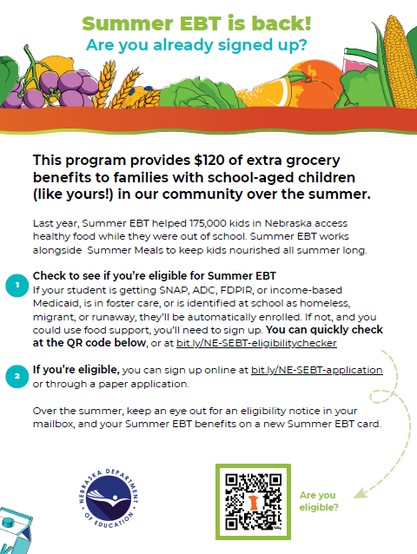
For CEP Schools:
Email, text, robo-call language, and a take- home flyer
Notes:
Read from slide

Slide 24
Outreach Kit Including Suggested Timeline
Timeline: When to share | Shareable resource
Between late April - late May (Awareness) | Social Media Post #1 CEP Schools: Email #1 Robocall or text Take-home flyer
Late May/As School Wraps Up (Reminder for CEP Schools) | CEP Schools: Social Media Post #2
June - early July (Program Purpose: SEBT + Summer Meals) | Social Media Post #3
Between late July - Aug 14 (Back to School/Don’t Miss Out!) | Social Media Post #4 CEP Schools: Email #2
August 1 - 22 (Don’t Forget to Use Your Benefits!) | Social Media Post #5
Notes:
Elyse
Talk through big picture of timing – when and why
Leverage school calendar – a push before school ends, to build awareness
especially in CEP schools, a push around back-to-school, before application closes (families will know if they’ve received automatically or not by this time – last chance!)
Notes to self:
School wraps approx May 23
app closes Aug 15. Back to school week of Aug 11 or Aug 18.

Slide 25

Find the Nebraska Summer EBT Outreach Kit at:
https://bestpractices.nokidhungry.org/NebraskaSEBTSchoolOutreach
Q & A
Please share your questions in the chat!
Notes:
All of these resources will be available shortly, at this website, and will be linked at NDE website

Slide 26

THANK YOU
Name
Title
jdoe@strength.org
000.000.000
Notes:
This is a thank you slide with the option of using a custom image that you select. You can insert a background photo by clicking the icon in the box, or dragging the photo directly from your files into the box.
Once the image is placed, you can use the CROP tool to reposition and resize the image within the boundaries.

Slide 27
How do Summer Meals and Summer EBT work together?
Notes:
For photo options, please refer to our Apple Cart photo library: https://shareourstrength.widencollective.com/portals/i19cklqf/PhotoCollectionsSubportal

Slide 28
This is a standard content slide.
Enter title for slide here.

Slide 29
What’s different about Summer EBT in 2025?
Notes:
For photo options, please refer to our Apple Cart photo library: https://shareourstrength.widencollective.com/portals/i19cklqf/PhotoCollectionsSubportal

Slide 30
This is a standard content slide.
Enter title for slide here.

Slide 31
This is a standard content slide.
Enter title for slide here.

Slide 32

Add Title Here
Add subtitle here
Day, Month, Year
PARTNER LOGO HERE

Slide 33

Add Title Here
Add subtitle here
Day, Month, Year
PARTNER LOGO HERE

Slide 34
This is a standard content slide.
Enter title for slide here.

Slide 35
Notes:
For photo options, please refer to our Apple Cart photo library: https://shareourstrength.widencollective.com/portals/i19cklqf/PhotoCollectionsSubportal

Slide 36


Notes:
For photo options, please refer to our Apple Cart photo library: https://shareourstrength.widencollective.com/portals/i19cklqf/PhotoCollectionsSubportal

Slide 37


Notes:
For photo options, please refer to our Apple Cart photo library: https://shareourstrength.widencollective.com/portals/i19cklqf/PhotoCollectionsSubportal

Slide 38
Divider Slide – add text here if needed
Notes:
For photo options, please refer to our Apple Cart photo library: https://shareourstrength.widencollective.com/portals/i19cklqf/PhotoCollectionsSubportal

Slide 39
Divider Slide – add text here if needed
Notes:
For photo options, please refer to our Apple Cart photo library: https://shareourstrength.widencollective.com/portals/i19cklqf/PhotoCollectionsSubportal

Slide 40
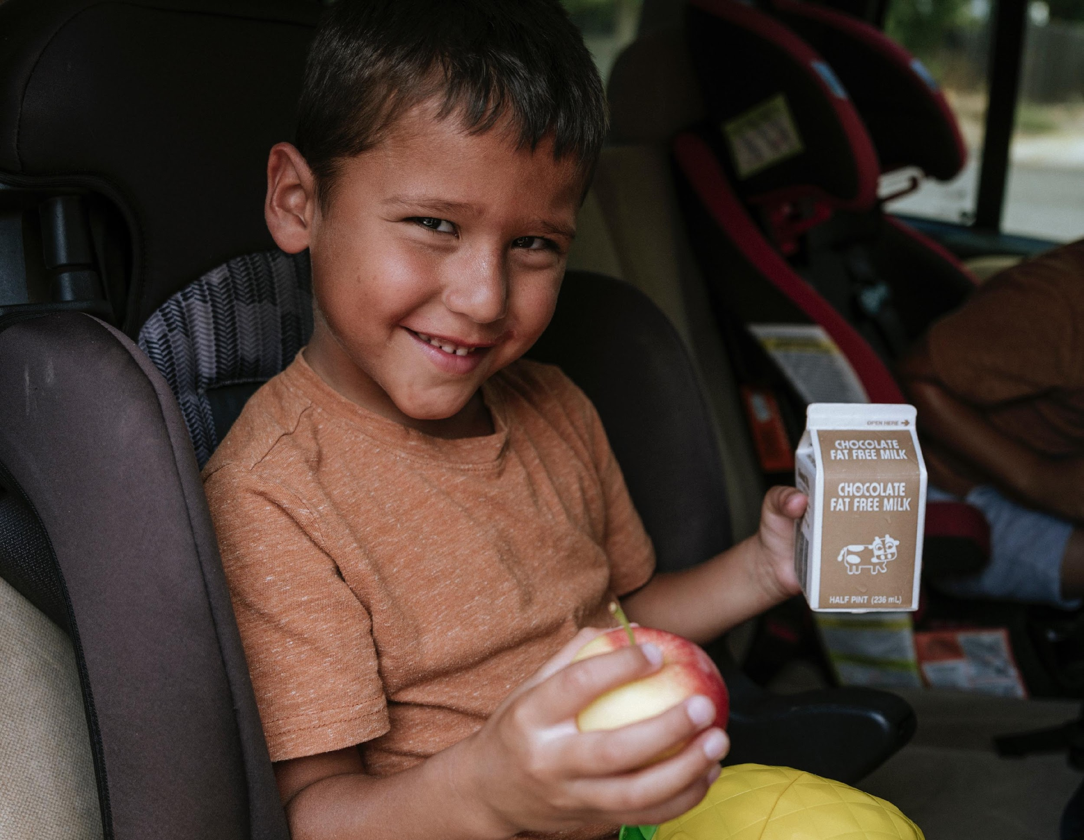



“Pull quotes are great ways to highlight information. Please contact the creative team for our storytelling assets if you need help finding good quotes”
— Make sure to attribute quote
Notes:
For photo options, please refer to our Apple Cart photo library: https://shareourstrength.widencollective.com/portals/i19cklqf/PhotoCollectionsSubportal

Slide 41



Text Here
Additional Text Here
Notes:
For photo options, please refer to our Apple Cart photo library: https://shareourstrength.widencollective.com/portals/i19cklqf/PhotoCollectionsSubportal

